Slide 1
PARCH AND POSEY COMPANY SALES REPORT
BY
PROMISE CHINONSO

Slide 2
Problem Statement
Parch and Posey is seeking to optimize its sales strategy and better understand its order trends across various dimensions, including time, region, customer behavior, and sales channels.

Slide 3
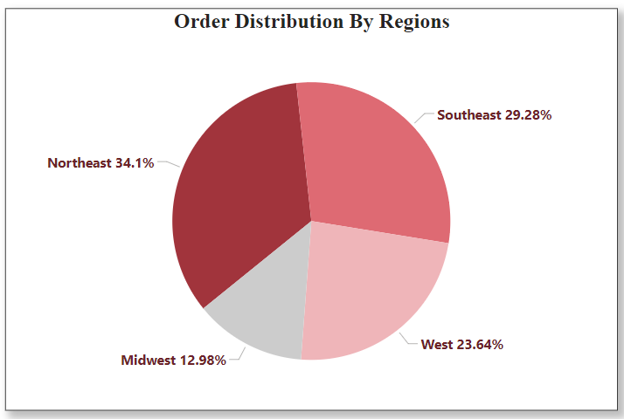
The company has recorded a bulk of its orders from the Northeast region, followed closely by the Southeast region. These 2 regions contribute to over 53% of the orders recorded.

Slide 4
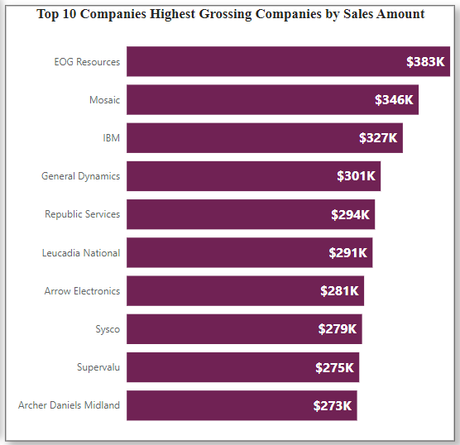
EOG Resources, Mosaic, IBM and General Dynamics are top grossing customers contributing over $300k each to the company’s overall revenue. The visual on the right shows the top 10 highest grossing companies.

Slide 5
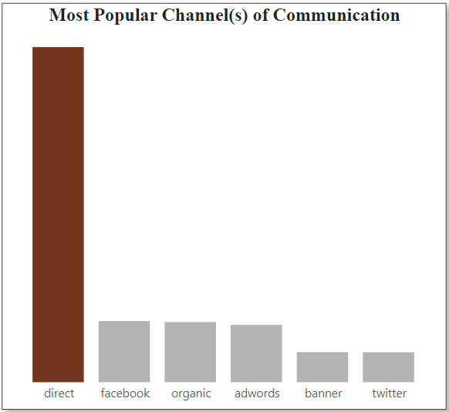
From the insight presented, majority of the customers prefer to communicate and engage the company via the direct means of communication making it the customer’s choice.

Slide 6
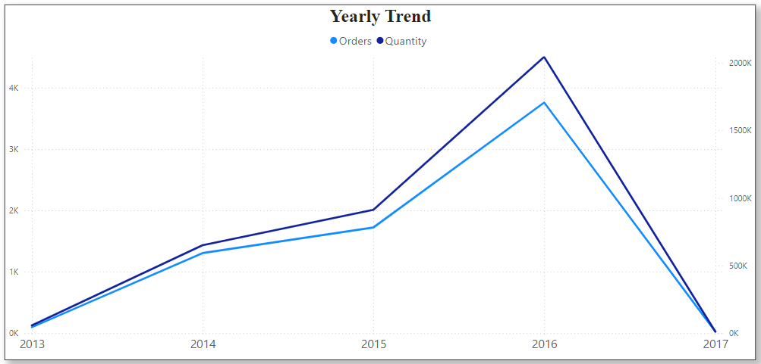
The yearly trend shows that between 2013 and 2017, the company recorded the most orders and sold the most quantity of goods in the year 2016. These metrics grew steadily overtime (2013-2016) but a sharp decline occurred in 2017.

Slide 7
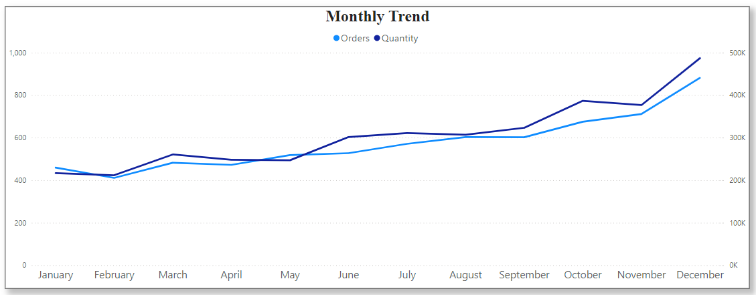
Like the yearly trend, the trend across months shows steady growth in the number of orders and quantity sold from Jan to Dec with the peak values being recorded in December.

Slide 8
Conclusion and Recommendation
Conclusion: Sales and order trends vary significantly across different months, regions, customers, and channels, indicating potential areas for growth and improvement in underperforming segments.
Recommendations:
Focus marketing efforts and promotions on regions and channels with lower sales volume to drive growth in those areas.
Strengthen customer retention by offering targeted discounts or incentives to customers with low order value.

